Slide 1
Chapter 16 Transmission Media

Slide 2
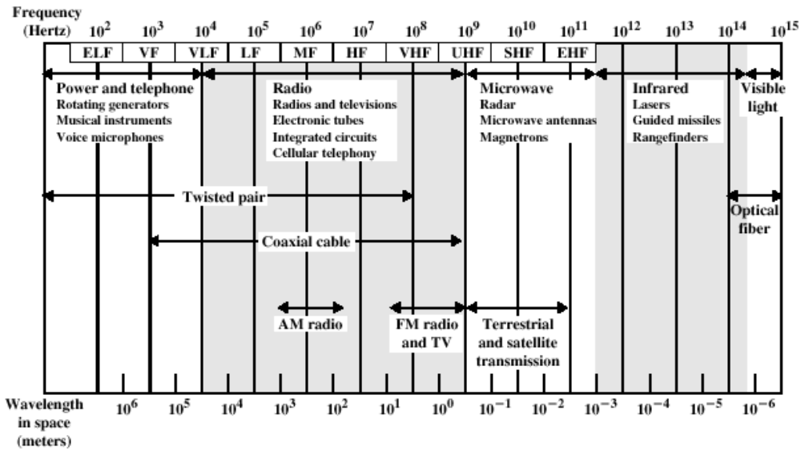
Transmission Media
Transmission medium: the physical path between transmitter and receiver.
Repeaters or amplifiers may be used to extend the length of the medium.
Electromagnetic Spectrum for Transmission Media

Slide 3
Guided Media and Unguided Media
Communication of electromagnetic waves is guided or unguided.
Guided media:
Waves are guided along a physical path
Use a conductor such as a wire or a fiber optic cable to move the signal from sender to receiver
Transmission capacity depends on the distance and on whether the medium is point-to-point or multipoint
Unguided media:
Use radio waves of different frequencies and do not need a wire or cable conductor to transmit signals (e.g., the atmosphere and outer space).

Slide 4
Design Factors for transmission media
Bandwidth: All other factors remaining constant, the greater the bandwidth of a signal, the higher the data rate that can be achieved.
Transmission impairments: Limit the distance a signal can travel.
Interference: Competing signals in overlapping frequency bands can distort or wipe out a signal.
Number of receivers: Each attachment introduces some attenuation and distortion, limiting distance and/or data rate.

Slide 5
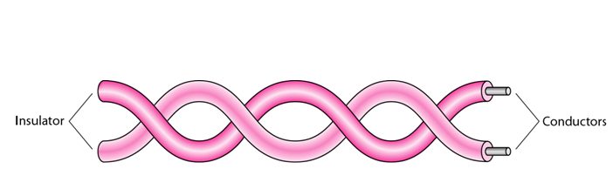
Guided Transmission Media-Twisted Pair
Twisted Pair consists of two insulated copper wires arranged in a regular spiral pattern to minimize the electromagnetic interference between adjacent pairs.
The signal is transmitted through one wire and a ground reference is transmitted in the other wire.
Usually installed in building during construction.

Slide 6
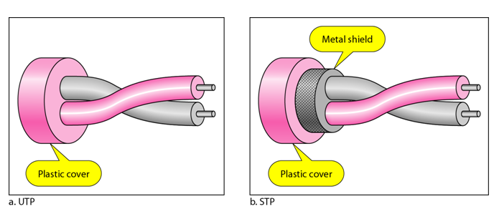
Types of twisted pair
STP (shielded twisted pair)
  the pair is wrapped with metallic foil to insulate the pair from electromagnetic interference
UTP (unshielded twisted pair)
  each wire is insulated with plastic wrap, but the pair is encased in an outer covering

Slide 7
Advantages and Disadvantages
Twisted Pair Advantages
Inexpensive and readily available
Flexible and light weight
Easy to work with and install
Twisted Pair Disadvantages
Susceptibility to interference and noise
Attenuation problem
  For analog, repeaters needed every 5-6km
  For digital, repeaters needed every 2-3km
Relatively low bandwidth (3000Hz

Slide 8
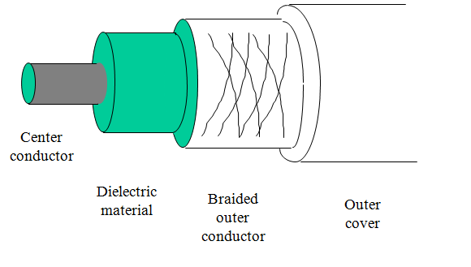
Coaxial Cable
Used for cable television, LANs, telephony
Has an inner conductor surrounded by a braided mesh
Both conductors share a common center axial, hence the term “co-axial”

Slide 9
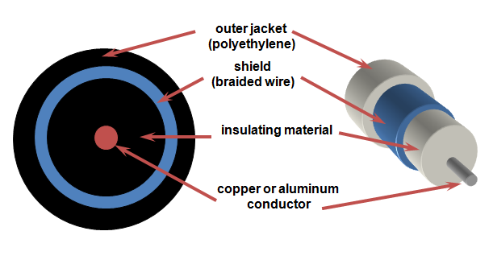
Coaxial Cable

Slide 10
Advantages
Higher bandwidth
  400 to 600Mhz
  up to 10,800 voice conversations
Can be tapped easily (pros and cons)
Much less susceptible to interference than twisted pair
Disadvantages
More expensive to install compare to twisted pair cable.
The thicker the cable, the more difficult to work with.

Slide 11
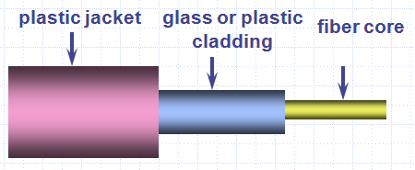
Fiber Optical Cable
Optical fiber is a thin flexible medium capable of conducting optical rays. Optical fiber consists of a very fine cylinder of glass (core) surrounded by concentric layers of glass (cladding).
Relatively new transmission medium used by telephone companies in place of long-distance trunk lines
Also used by private companies in implementing local data communications networks
Require a light source with injection laser diode (ILD) or light-emitting diodes (LED)

Slide 12
Fiber Optical Cable
Optical fibers use reflection to guide light through a channel. A glass or plastic core surrounded by a cladding of less dense glass or plastic. The difference in density of the two materials must be such that a beam of light moving through the core is reflected off the cladding instead of being refracted into it. Information is encoded onto a beam of light as a series of on-off flashes that represent 1 and 0.

Slide 13
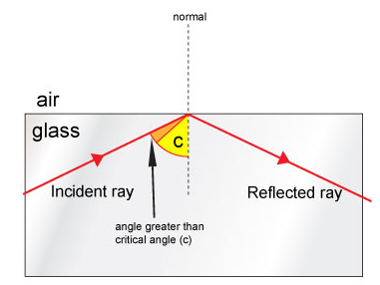
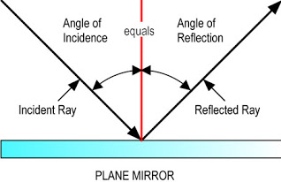
Fiber Optical Cable
A signal-encoded beam of light (a fluctuating beam) is transmitted by total internal reflection. (The complete reflection of a light ray reaching an interface with a less dense medium when the angle of incidence exceeds the critical angle.)

Slide 14
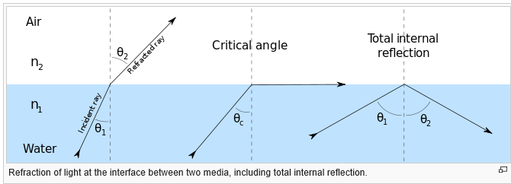
Fiber Optical Cable
Total internal reflection occurs in the core because it has a higher optical density (index of refraction) than the cladding.
Attenuation in the fiber can be kept low by controlling the impurities in the glass.

Slide 15
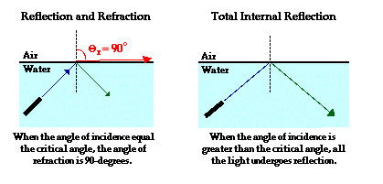
What is Critical Angle?
Total internal reflection (TIR) is the phenomenon that involves the reflection of the entire incident light off the boundary. TIR only takes place when both of the following two conditions are met:
A light ray is in the denser medium and approaching the less dense medium..
The angle of incidence for the light ray is greater than the so-called critical angle.
Let us consider the example of light travelling through water towards the boundary with a less dense material such as air. When the angle of incidence in water reaches a certain critical value, the refracted ray lies along the boundary, having an angle of refraction of 90-degrees. This angle of incidence is known as the critical angle; it is the largest angle of incidence for which refraction can still occur.

Slide 16
What is Critical Angle?
So the critical angle is defined as the angle of incidence that provides an angle of refraction of 90-degrees. Make particular note that the critical angle is an angle of incidence value. For the water-air boundary, the critical angle is 48.6-degrees. For the crown glass-water boundary, the critical angle is 61.0-degrees. The actual value of the critical angle is dependent upon the combination of materials present on each side of the boundary.

Slide 17
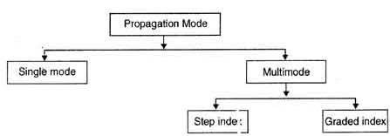
Propagation Modes
Multimode
Multimode is so named because multiple beams from a light source move through the core in different paths. How these beams move within the cable depends on the structure of the core.

Slide 18
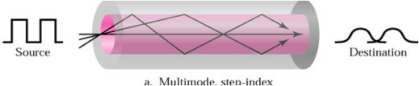
Multimode step index
In multimode step-index fiber, the density of the core remains constant from the centre to the edges.
A beam of light moves through this constant density in a straight line until it reaches the interface of the core and the cladding.
At the interface, there is an abrupt change to a lower density that alters the angle of the beam’s motion.
The term step-index refers to the suddenness of this change.

Slide 19
Multimode step index
Some beams in the middle travel in straight lines through the core and reach the destination without reflecting and refracting.
Some beams strike the interface of the core and cladding at an angle smaller than the critical angle; these beams penetrate the cladding and are lost.
Still other hit the edge of the core at angles greater than the critical angle and reflect back into the core and off the other side, bouncing back and forth down the channel until they reach the destination.

Slide 20
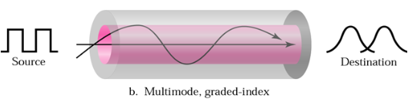
Multimode graded index
Multimode graded-index fiber, decreases the distortion of the signal through the cable.
A graded-index fiber is one with varying densities.
Density is highest at the centre of the core and decreases gradually to its lowest at the edge.
The impact of this variable density on the propagation of light beams is shown below:

Slide 21
Single Mode
Single mode uses step-index fiber and a highly focused source of light that limits beams to a small range of angles and close to the horizontal.
The single mode fiber itself is manufactured with a smaller diameter than that of multimode fibers, with substantially lower density.
The decrease of density results in a critical angle that is close enough to 90 degrees to make the propagation of beams almost horizontal.
In this case propagation of different beams is almost identical and delays are negligible.
All of the beams arrive at the destination “together" and can be recombined without distortion to the signal.

Slide 22
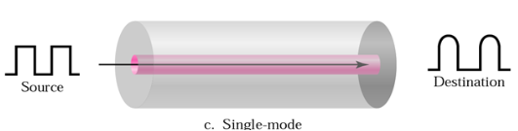
Single Mode

Slide 23
Advantages
greater capacity (bandwidth of up to 2 Gbps)
smaller size and lighter weight
lower attenuation
immunity to environmental interference
highly secure due to tap difficulty and lack of signal radiation
Disadvantages
expensive over short distance
requires highly skilled installers
adding additional nodes is difficult

Slide 24
Wireless Transmission
Transmission and reception are achieved by means of an antenna
directional
  transmitting antenna puts out focused beam
  transmitter and receiver must be aligned
omnidirectional
  signal spreads out in all directions
can be received by many antenna

Slide 25
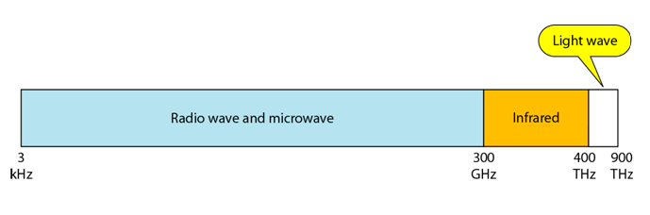
Wireless Example
Radio Wave
Microwave
Infrared
Electromagnetic spectrum for wireless communication

Slide 26
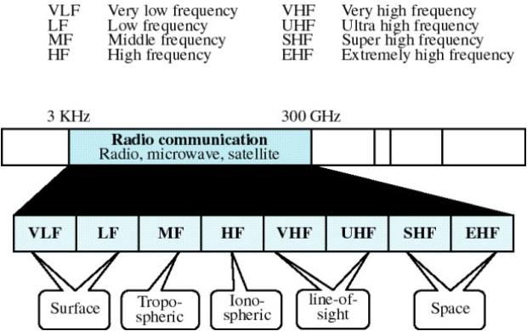
Propagation of Radio waves-Cont.

Slide 27
Propagation of Radio waves-Cont.
Radio technology considers the earth as surrounded by two layers.
The troposphere is the portion of the atmosphere extending outward approximately 30 miles from the earth’s surface and contains what we generally think of as air.
Clouds, winds, temperature variations, and weather in general occur in the troposphere.
The ionosphere is the layer of the atmosphere above the troposphere but below space.
It is beyond what we think of as atmosphere and contains free electrically charged particles (hence the name).

Slide 28
Propagation of Radio waves-Cont.
Radio wave propagation utilizes five different types of propagation:
Surface
Tropopheric
Ionospheric
Line-of-sight
Space propagation

Slide 29
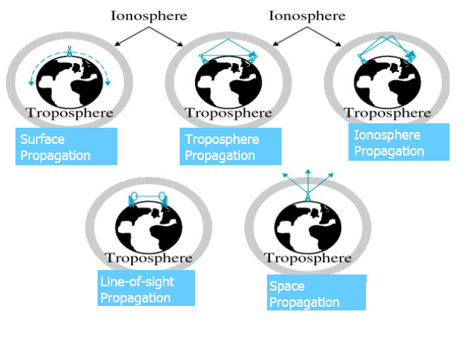
Types of Propagation

Slide 30
Surface Propagation
Radio Waves travel through the lowest portion of the atmosphere, hugging the earth.
At lowest frequencies, signals emanate in all directions and follow the curvature of the planet.
Distance depends on the amount of power in the signal.: The grater the power, the greater the distance.
Surface propagation can also take place in seawater.

Slide 31
Tropospheric Propagation
Troposphere is the lower layer of atmosphere.
It can work in two ways.
Either a signal can directed in a straight line from antenna to antenna (light-of-sight), or it can be broadcast at an angle into the upper layers of the troposphere where it is reflected back to the earth’s surface.
The first method requires that the placement of the receiver and the transmitter be within line-of-sight distance, limited by the curvature of the earth in relation to the height of the antennas.
The second method allows greater distance to be covered.

Slide 32
Ionospheric Propagation
The ionosphere is where Earth's atmosphere meets space.
Higher-frequency radio waves radiate upward into the ionosphere where they are reflected back to earth.
The density difference between the troposphere and the ionosphere causes each radio wave to speed up and change direction, bending back to earth.
This type of transmission allows for greater distances to be covered with lower power output.

Slide 33
Line-of-Sight Propagation
Very high frequency signals are transmitted in straight lines directly from antenna to antenna.
Antennas must be directional, facing each other, and either tall enough or close enough together not to be affected by the curvature of the earth.
Line-of-sight propagation is tricky because radio transmissions cannot be completely focused.
Waves emanate upward and downward as well as forward and can reflect off the surface of the earth or part of the atmosphere.
Reflected waves that arrive at the receiving antenna later than the direct portion of the transmission can corrupt the received signal.

Slide 34
Space Propagation
Utilizes satellite relays in place of atmospheric refraction.
A broadcast signal is received by an orbiting satellite, which rebroadcasts the signal to the intended receiver back on the earth.
Satellite transmission is basically line-of-sight with an intermediary.
The distance of the satellite from the earth makes it the equivalent of a super-high-gain antenna and dramatically increase the distance coverable by a signal.

Slide 35
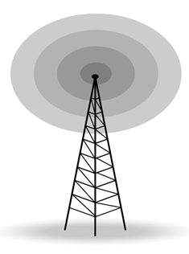
Radio Wave
Used for multicast communications, such as radio and television.
Can penetrate through walls.
Highly regulated.
Use omnidirectional antennas

Slide 36

Microwave
Microwaves are used for unicast communication such as cellular telephones, satellite networks and wireless LANs.
Higher frequency ranges cannot penetrate walls.
Use directional antennas - point to point line of sight communications.

Slide 37
Terrestrial Microwave
used for long-distance telephone service
uses radio frequency spectrum, from 2 to 40 Ghz
parabolic dish transmitter, mounted high
used by common carriers as well as private networks
requires unobstructed line of sight between source and receiver
curvature of the earth requires stations (repeaters) ~30 miles apart

Slide 38
Satellite Microwave Transmission
a microwave relay station in space
can relay signals over long distances
geostationary satellites
  remain above the equator at a height of 22,300 miles (geosynchronous orbit)
  travel around the earth in exactly the time the earth takes to rotate
earth stations communicate by sending signals to the satellite on an uplink
the satellite then repeats those signals on a downlink
the broadcast nature of the downlink makes it attractive for services such as the distribution of television programming

Slide 39
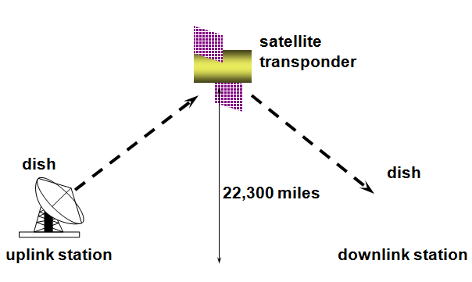
Satellite Transmission Process

Slide 40
Principal Satellite Transmission Bands
C band: 4(downlink) - 6(uplink) GHz
  the first to be designated
Ku band: 12(downlink) -14(uplink) GHz
  rain interference is the major problem
Ka band: 19(downlink) - 29(uplink) GHz
  equipment needed to use the band is still very expensive

Slide 41
Satellite Microwave Application
Television distribution
Long-distance telephone transmission
Private business networks
Satellite Microwave Disadvantages
line of sight requirement
expensive towers and repeaters
subject to interference such as passing airplanes and rain

Slide 42
Infrared
Signals can be used for short-range communication in a closed area using line-of-sight propagation.
Unlike microwaves, infrared does not penetrate walls.

Slide 43
Question
What are the advantages and disadvantages of twisted pair and coaxial cable?
Differentiate between guided and unguided media.
Briefly explain Surface propagation, Tropospheric propagation, Ionospheric Propagation, Line-of-sight propagation and Space propagation.

